Slide 1
Inside the WindowNT Registry

Slide 2
Overview
Hives
Hive Structure
Cell Maps
The Registry Namespace and Operation
Stable Storage
Registry Optimizations
The End of the Tour

Slide 3
Hives
On disk, the Registry isn't simply one large file but a set of discrete files called hives.
Each hive contains a Registry tree,
has a key that serves as the root (i.e., starting point) of the tree.
Subkeys and their values reside beneath the root.

Slide 4
Table 1 Regedit Root Keys
Key | Description
HKEY_CLASSES_ROOT | Symbolic link to HKEY_LOCAL_MACHINE \SOFTWARE \Classes.
HKEY_CURRENT_USER | Symbolic link to a key under HKEY_USERS representing a user's profile hive.
HKEY_LOCAL_MACHINE | Placeholder with no corresponding physical hive. This key contains other keys that are hives.
HKEY_USERS | Placeholder that contains the user-profile hives of logged-on accounts.
HKEY_CURRENT_CONFIG | Symbolic link to the key of the current hardware profile under HKEY_LOCAL_MACHINE \SYSTEM CurrentControlSet\ Control\IDConfigDB\Hardware Profiles.
HKEY_DYN_DATA | Placeholder for performance data lookups. This key has no corresponding physical hive.

Slide 5
Table 2 Hive Registry Paths and Corresponding On-Disk Files
Hive Registry Path | Hive File Path
HKEY_LOCAL_MACHINE \SYSTEM | \winnt\system32\config\system
HKEY_LOCAL_MACHINE \SAM | \winnt\system32\config\sam
HKEY_LOCAL_MACHINE \SECURITY | \winnt\system32\config\security
HKEY_LOCAL_MACHINE \SOFTWARE | \winnt\system32\config\software
HKEY_LOCAL_MACHINE \HARDWARE | Volatile hive
HKEY_LOCAL_MACHINE \SYSTEM \Clone | Volatile hive
HKEY_USERS \UserProfile | Profile; usually under \winnt\profiles\usere
HKEY_USERS.DEFAULT | \winnt\system32\config\default

Slide 6
Tables 1 and 2 observation
Some hives are volatile and don't have associated files.
The system creates and manages these hives entirely in memory
the hives are therefore temporary in nature.
The system creates volatile hives every time the system boots.
An example of a volatile hive is the HKEY_LOCAL_MACHINE \HARDWARE hive,
stores information regarding physical devices and the devices' assigned resources.
Resource assignment and hardware detection occur every time the system boots, so not storing this data on disk is logical.

Slide 7
Tables 1 and 2 observation: Most important hive: HKEY_LOCAL_MACHINE \SYSTEM
It’s subkey
\CurrentControlSet\Control
The subkey
contains settings for initializing the Registry.
Configuration Manager
Using the settings to initialize hives
HKEY_LOCAL_MACHINE \SYSTEM \CurrentControlSet \Control \hivelist.

Slide 8
Tables 1 and 2 observation: symbolic link
redirects the Configuration Manager to another key.
the key HKEY_LOCAL_MACHINE \SAM is a symbolic link to the key at the root of the SAM hive.
Configuration Manager uses it
to link hives to organize the Registry.

Slide 9
Hive Structure-block
The Configuration Manager logically divides a hive into allocation units called blocks
Similar to a file system divides a disk into clusters.
Registry block size is 4096 bytes
The first block of a hive is the base block.
The base block includes
global information about the hive,
including a signature—regf—that identifies the file as a hive,
updated sequence numbers,
a timestamp that shows the last time a write operation initiated on the hive,
the hive format version number,
a checksum, and
the hive file's full name
e.g., SystemRoot\CONFIG\SAM

Slide 10
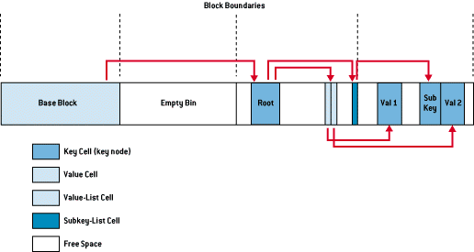
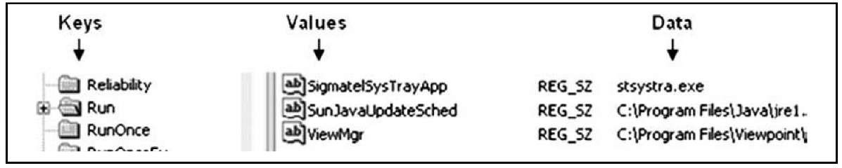
Hive Structure-Cell
Is a container
The way that NT organizes the Registry data
A cell can hold
a key node,
e.g., LastWrite time for the key node (kn) ,
a value and data (kv),
a security descriptor,
a list of subkeys, or
a list of key values.
Bin
allocation unit
Two bins in Figure
created by a system in a block
hold the cell
A bin is the size of the new cell rounded up to the next block boundary.
have headers that contain
a signature, hbin, and
a field that records the offset into the hive file of the bin and
the bin's size.

Slide 11
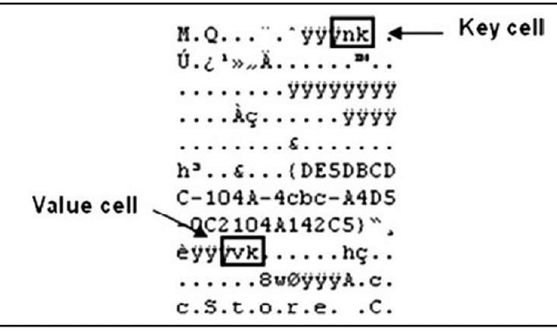
Raw Registry File Showing Key and Value Cell Signatures

Slide 12
The Registry As a Log File
The key cells within the Registry constitute
The keys or folders you see when you open the Registry Editor.
This is the only one of the structures that contains
a time value, called the LastWrite time.
The LastWrite time is a 64-bit FILETIME object, which is analogous to the last modification time on a file.
provide a time frame reference for certain user activities on the system,
tell you when a specific value was added to a key or was modified.

Slide 13
LastWrite time Examples
Open the Registry Viewer in ProDiscover and locate the area where Registry keys specific to Windows services are maintained.
Sort the first level of keys based on their LastWrite times, and invariably
You can easily locate services that were installed during the intrusion,
such as remote access backdoors or
even rootkits.
http://vil.nai.com/vil/Content/v_140546.htm

Slide 14

Lab: regshot to take a snapshot of registry before and after insert a USB

Slide 15
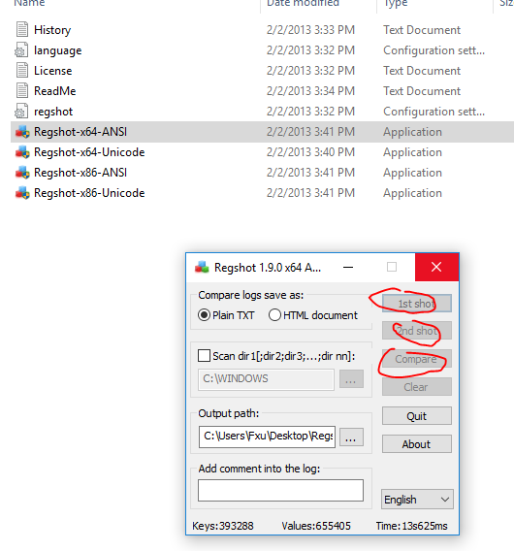
Snap shoots

Slide 16
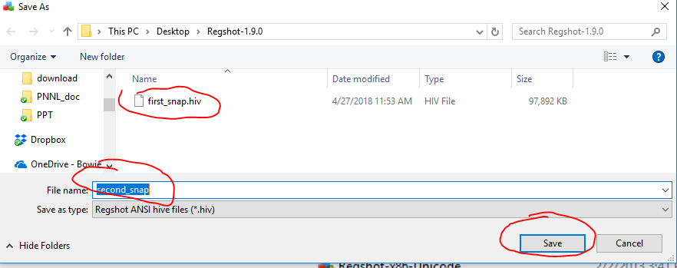
Two Snaps

Slide 17
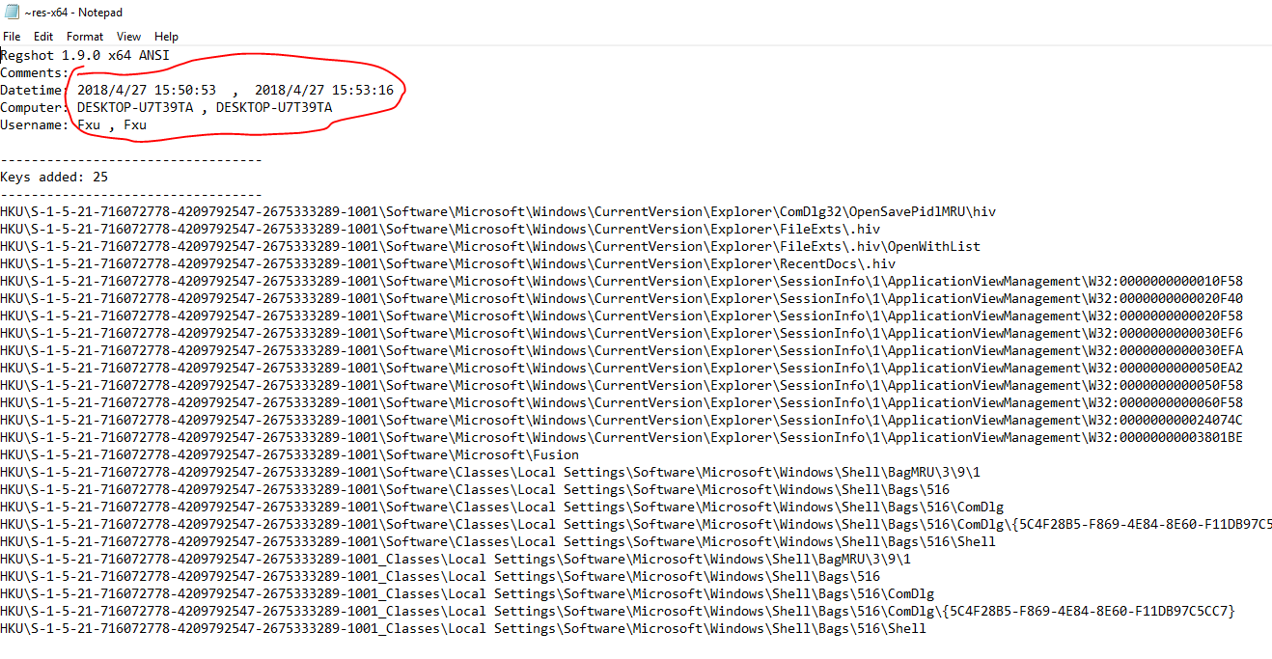
Comparing Difference

Slide 18
Reference
https://technet.microsoft.com/en-us/library/cc750583.aspx
http://what-when-how.com/windows-forensic-analysis/registry-analysis-windows-forensic-analysis-part-3/

